Slide 1

FULL STACK PROJECT PRESENTATION
2020-21
Department of Computer Engineering and Applications
GLA University, Mathura
Uttar Pradesh, India

Slide 2

The Writer Next Door
A blog website
Submitted by-
Mohit Tiwari (181500392)
Yash Srivastava (181500829)
Saurabh Tripathi (181500641)

Slide 3

Contents
INTRODUCTION
- Motivation
- Main Idea
TECHNOLOGIES USED IN THIS PROJECT
- HTML5
- CSS3
- JavaScript
- JQuery
- Bootstrap
- Node .js
- Express .js
- MongoDB
CONTRIBUTION SUMMARY
LIVE DEMO SESSION
CONCLUSION

Slide 4

Introduction
Motivation Behind The Project:
In this cut throat competition, full stack development is one of those fields that is experiencing great demand in IT industries. It has gained a lot of scope in the topnotch industries.
For this, it is important to have practical knowledge of languages and build projects that can be utilized and worked upon in future and among such projects is “The Writer Next Door – A Blog Website.

Slide 5

Main Idea Behind the Project
In this digital era where every skill or talent needs to be outreached to people to gain engagement, there comes a need to provide an open platform to all those writers who want to publish their write- ups and want the world to engage and appreciate their work.
This will assist them in boosting their skills and will also help them to connect with new writers.

Slide 6





Technology
Used
HTML5
CSS3
Bootstrap
JavaScript
jQuery
Node .js
Express .js
MongoDB

Slide 7

Contribution Summary
Yash Srivastava
FullStack Developer
1
Mohit Tiwari
FullStack Developer
2
Saurabh Tripathi
FullStack Developer
3

Slide 8
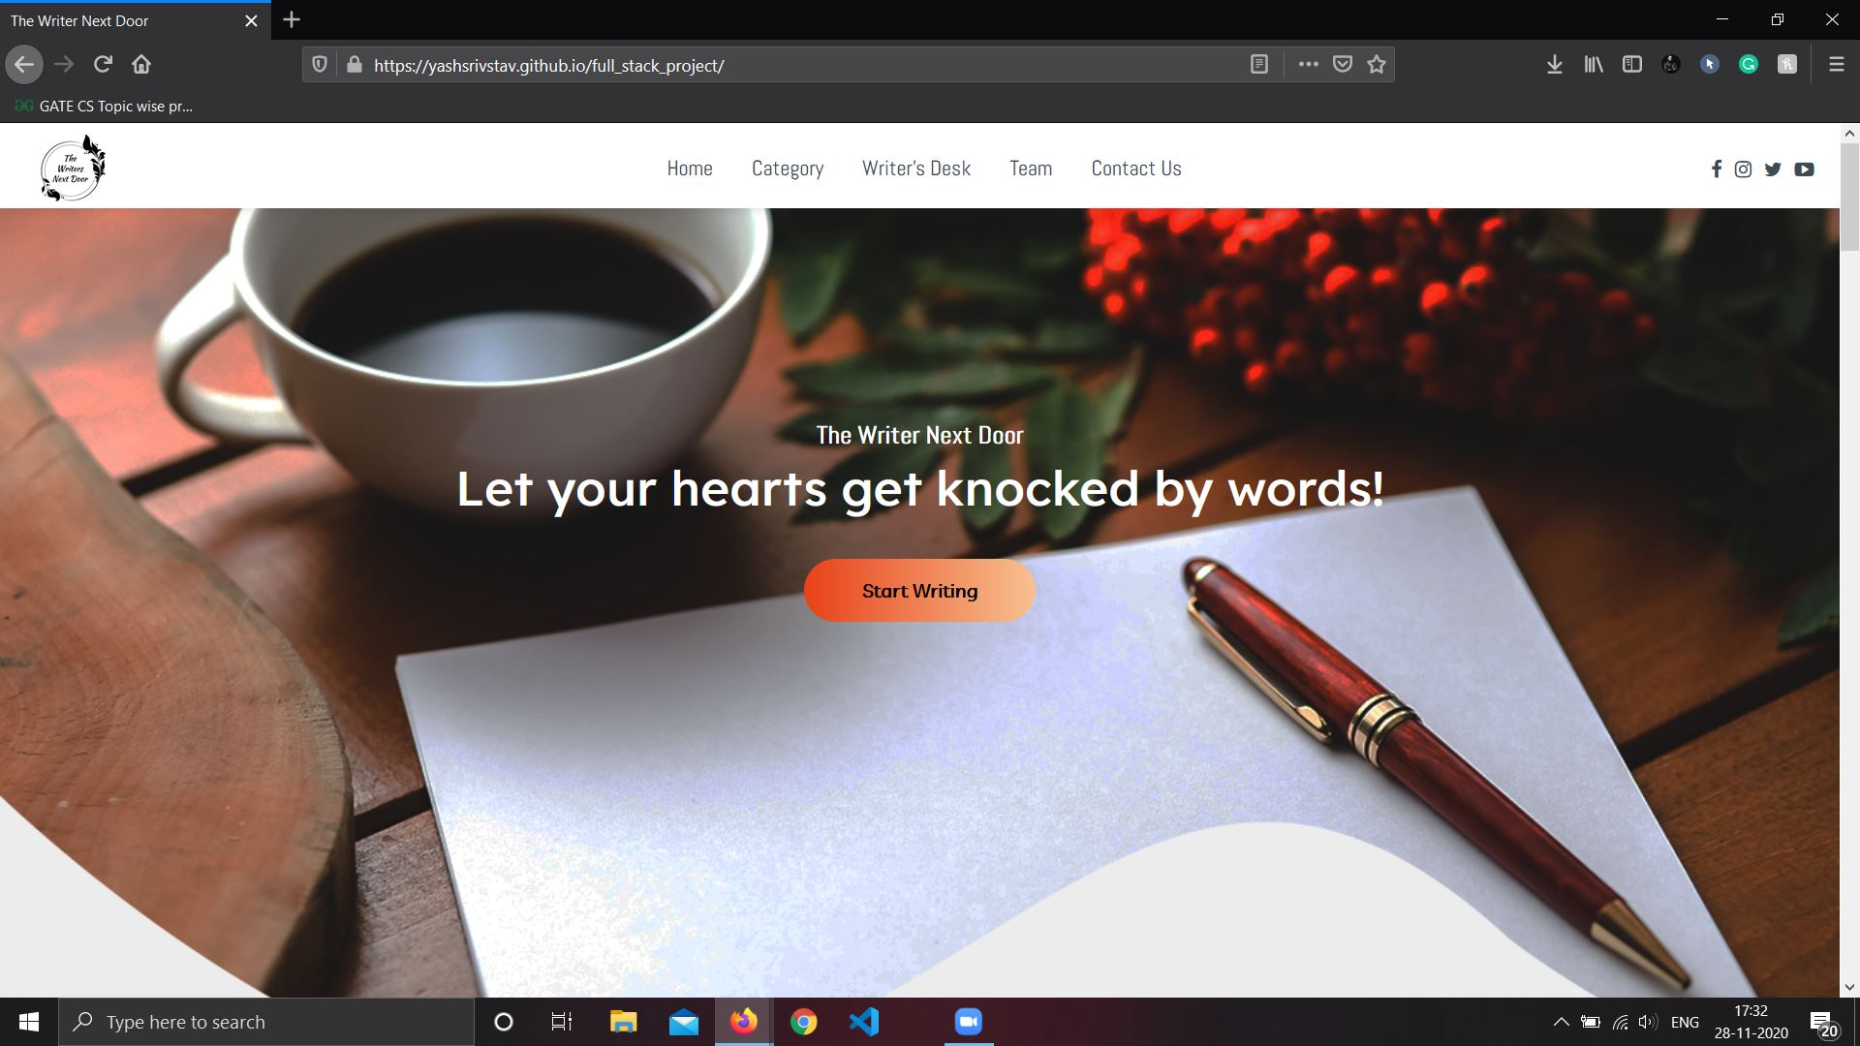
Live Demo
Heroku URL: Live Link

Slide 9

Conclusion
From proper analysis of positive points and constraints on the platform, it can be safely concluded that "The Writer Next Door" is efficient UI based platform. This platform can be easily used in many other systems. Also, this website is user friendly.

Slide 10

Thanks!
We are up for
Questions!

